Slide 1

FedSmart An Auto Updating FederatedLearning Optimization Mechanism
http://arxiv.org/abs/2009.07455v1
Yifan Bu 2020.9.21

Slide 2

The main contributions of the paper
Demonstrate the impact and performance of using non-IID data on both FL frameworks and local training.
Adopt independent validation sets in each side instead of shared data sets to improve the model performance on non-IID data.
contributions
Propose a new parameter joint method FedSmart to make the multi-party joint value of the stochastic gradient descent close to the unbiased estimate of the complete gradient.

Slide 3
Related Work
2.1 Average-Based Optimization Algorithm
FederatedAveraging (FedAvg) based on iterative model average is proposed for non-IID FL, which can be applied to real scenarios.
FedSGD B=1 E=1
2.2 Performance-Based Optimization Algorithm
a loss-based AdaBoost federated machine learning algorithm (LoAdaBoost), which further optimizes the local model with high cross-entropy loss before averaging the gradients on the central server.
FedProx, proposed by [12], lowers the potential damage to the model caused by non-IID data.
SCAFFOLD introduces a new variable combined with gradients, decreasing the variance of local iteration [8].

Slide 4
Approach-Abstract
FedSmart
1.In this mechanism, the FL participant is smart enough to gain information from others who have similar data property.
2.In another aspect, FedSmart can be used to test whether the model from other clients is useful to every client’s side.
3.Furthermore, FedSmart can be treated as a kind of latent incentive mechanism, the selfish sides who provide unrealistic or unqualified data will be naturally filtered out via decreasing the weight, only the ones who provide their valuable data can benefit from the group with the similar distributions.

Slide 5
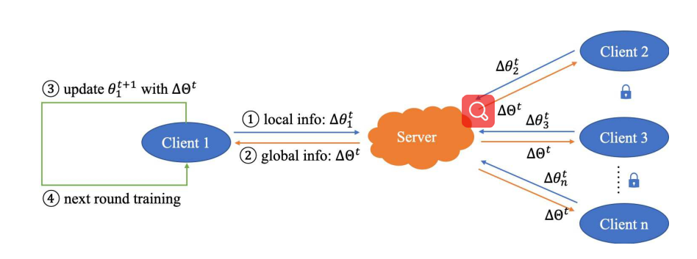
Approach-The Information Transfer Framework
All clients do the training respectively using local data. After the model is updated, each client sends the local model information to the server. Clients send the gradient training with their local data to the server; the server packs these changes and sends back, i.e. ∆Θt(∆θ1t, ∆θ2t, ..., ∆θnt ) (see Fig. 1).

Slide 6
Approach-The Local Model Updating Mechanism
The local model updating mechanism considers the mutual predicting ability of non-IID data. If all clients train only one global model, it will inevitably lead to distribution or sample size discrimination. FedSmart is designed to update the local model in the form of weights, which makes the model prefer to its self-side data. This approach actually optimizes the server model with the data from each client. At the time of initialization, the server initializes the model. When all clients receive the initial model, they will conduct a batch-size training and then launch the information transfer as mentioned above.

Slide 7
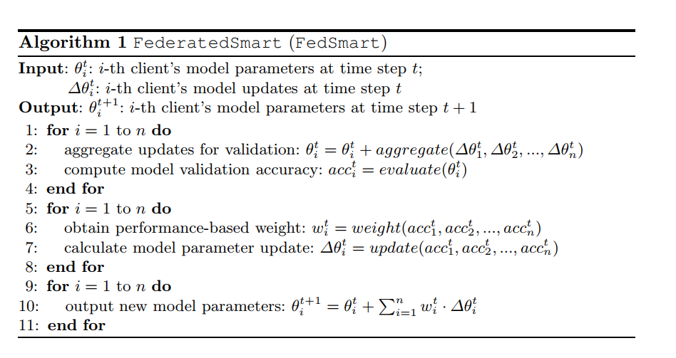
Approach-Performance-Based Weight Allocation
The performance of all the clients is taken into consideration, the principle, in brief, is that the weight of model will be smartly adjusted to the accuracy of each client. ||wit|| = ||wit-1 + η(acct i - acct median)||1 (1)
where accti represents the accuracy of Client i on local validation set in round t on the validation set, acct median is the median of the set of accuracy, and η is the learning rate.
The validation set is extracted from each client with a proportion of α ∈ [0, 1], and only serves for this client.

Slide 8
Experiment
Data
The data that concerned with the performance evaluation is the simulated datasets of MIMIC-III database [6,7], which contains the health information for critical care patients at a large tertiary care hospital in the U.S.
Experiment Settings
To illustrate the limited performance of FL on non-IID data, the data are constructed as a collective form of six heterogeneous data sets. In detail, Client1 and Client4, Client2 and Client5, Client3 and Client6 in pairs share a similar data distribution respectively.
The validation set proportion α is set to 0.25 in default all through the experiment.

Slide 9
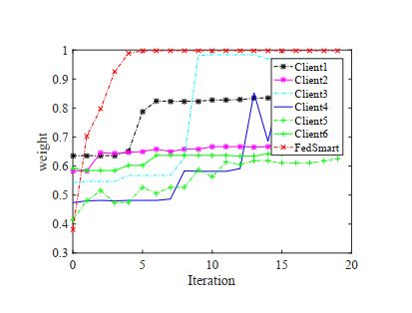
Experiment FedSmart v.s. Local Training
All FL participants will gain a better model with in the information sharing framework than only using their own data.

Slide 10
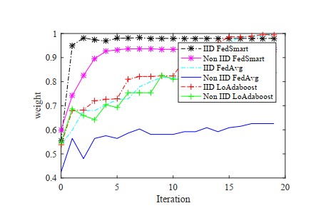
Experiment FedSmart v.s. FedAvg v.s. LoAdaBoost
To illustrate the effectiveness of FedSmart, we will do a comparison among FedSmart, FedAvg and LoAdaBoost.
In FedAvg, the server only receives the model parameters and returns the updated model parameters, and there is no interactive updating mechanism in FedAvg.
LoAdaBoost receives the loss and parameters of the model, and combines the information of the two to update the weight of the previous iteration [5].
FedSmart adopts different parameter combinations to update the model to make it approximate to the unbiased estimate of the complete gradient. The result is shown in Fig. 3.
FedSmart uses the accuracy of the validation set to measure the similarity of the distribution, establishes multiple models by adjusting the weights of different client models, and establishes multiple models on multiple clients only through the encrypted parameter exchange.

Slide 11
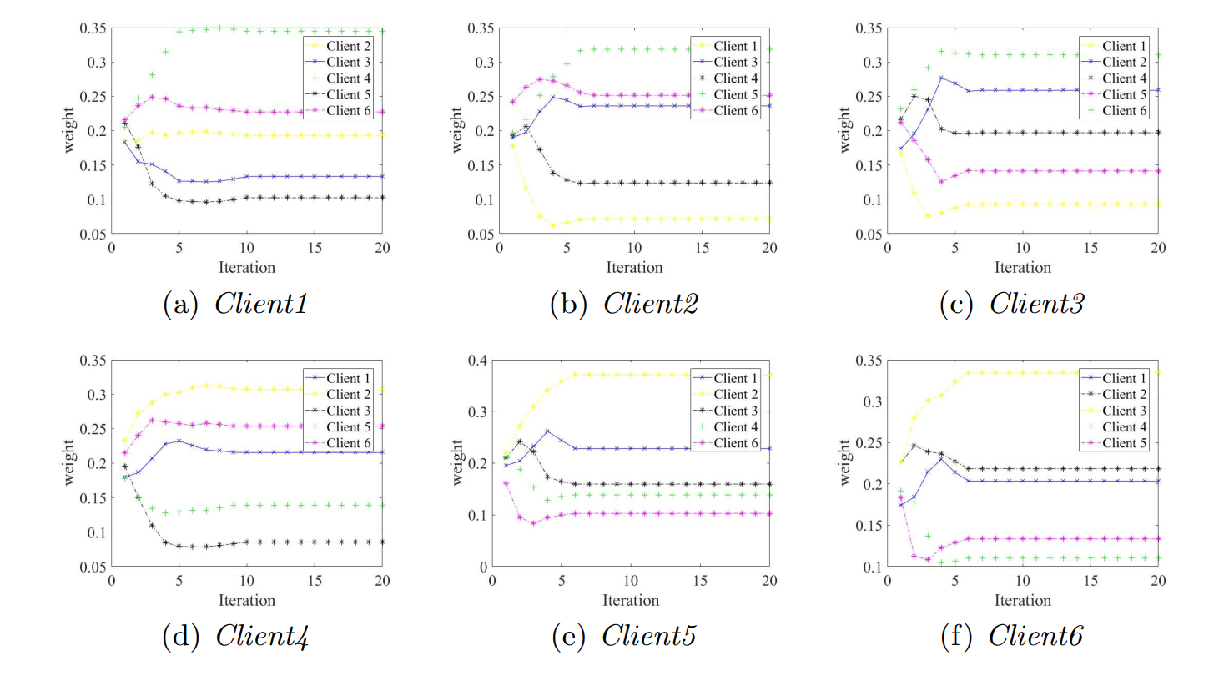
Experiment FedSmart
To further explain the working mechanism and performance of FedSmart, the process of the parameter joint weight changing during the training process is shown as in Fig. 4.
The weight appears to change in pairs: Client1 and Client4, Client2 and Client5, Client3 and Client6, which is in accordance with our experimental settings, indicating that FedSmart is figuring out good data.
normally we only have one global model to be established, to reduce the global loss and improve the accuracy, there is inevitably a decrease in the performance improvement caused by the fact that one of the distributions is ignored to some extent.

Slide 12
Conclusions
We propose a performance-based parameter return method FedSmart. It is different from the general idea that FL shares one global model. Instead, FedSmart establishes multiple models by treating each client as a server to make its own model perform the best.
In the continuation of our study, to compensate for this shortcoming and minimize the leakage of privacy caused by model delivery, FedSmart can use the drop-out-like mechanism to make it difficult for training participants to obtain effective information from the changes of the model. Also, we will improve and explore the FedSmart algorithm to make it to be generally stable and adaptable for both IID and Non-IID datasets, to tackle the root of problems for FL frameworks.

Slide 13

Made by Yifan Bu
2020.9.21
THANK YOU

